Slide 1
Impact of Mobility on Pollution Levels in the USA during Initial lockdown of Covid-19
By Indu Dharavath

Slide 2
Objective:
Population and Mobility influencing the susceptibility of multiple air pollutants during the initial lockdown due to Covid-19(Mar 2020-June 2020).
Geographic Scope:26 states of USA(for now)
Time Period:
Daily data from Feb to Dec of 2020(during and after lockdown comparison)
The start and end dates of lockdown measures varied depending on the specific state or locality.
Lockdown period: March-June,2020
After lockdown period:July-Dec,2020

Slide 3
Source of data:
Pollution data: Hourly CO data for the year 2020. Link
Population information: Population of cities in US. Link
Mobility data: Google Mobility & Bureau of Transportation Statistics(BTS)
Location of cites: Over 109,000 cities and towns data from all 50 states. Link
CO Pollution Data:
Colorless, odorless gas emitted primarily from vehicle exhaust and burning of fossil fuels.
EPA collects daily sample measurements of CO pollution levels across the United States

Slide 4
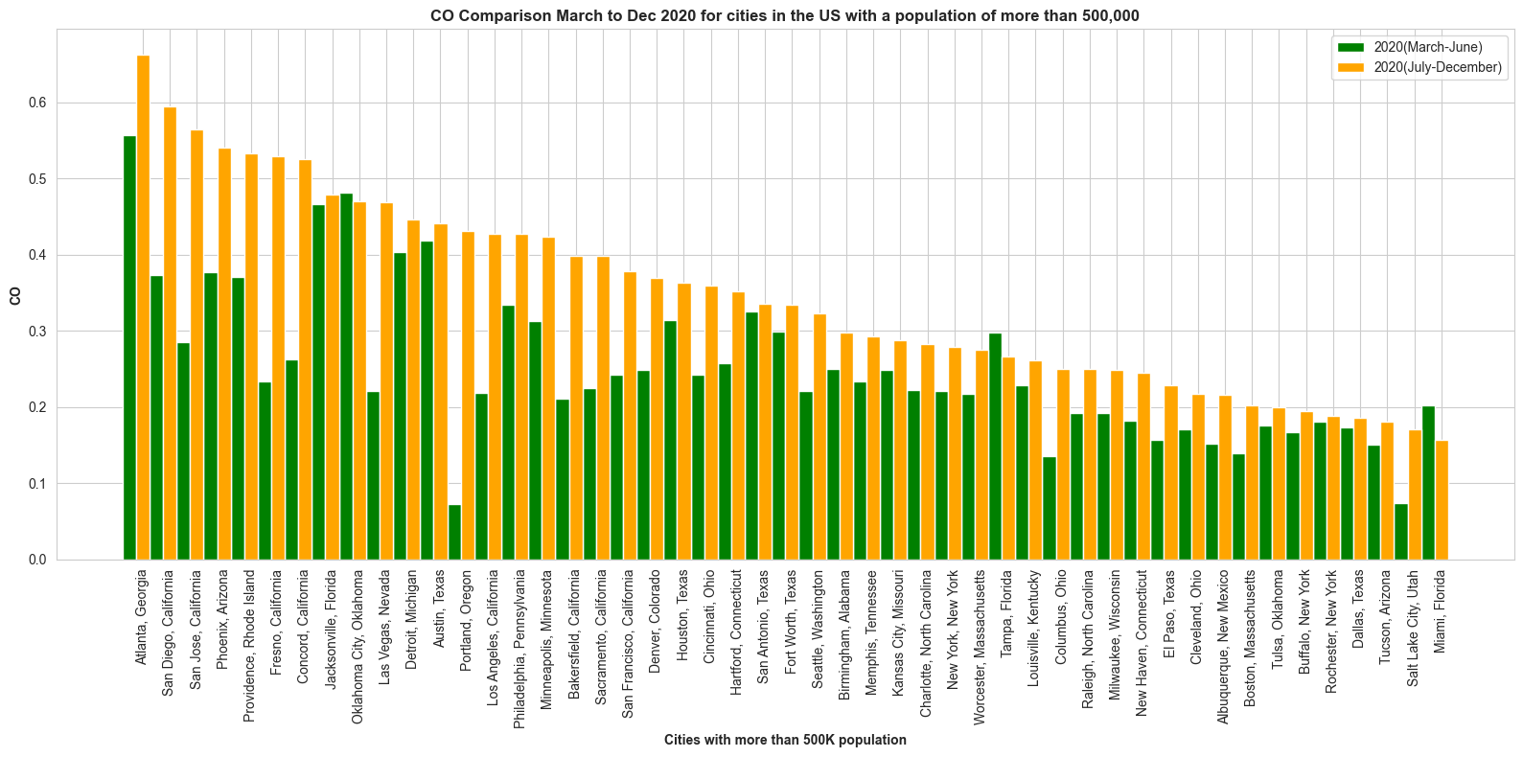
Visualization comparing CO levels in cities with populations over 500k (Mar-Dec,2020)

Slide 5
Interpretation based on the visualization (Mar-Dec ,More than 500K)
Among 49 cities in 26 states with a population of more than 500k Atlanta Georgia, San Diego-California, San Jose-California and other 37 cities experienced an increased mean amount of CO pollution > 0.025 after the lockdown.
The amount of CO emission in 9 other cities decreased after the lockdown compared to the same period in the year during the lockdown.
From above analysis we can conclude that the pollution has increased after lockdown ended and
Including mobility data here will help to analyse the major factors affecting the increase in pollution

Slide 6
Mobility Data
Due to the infectiousness of covid-19 the mobility of individuals has decreased, both in response to govt policy and self protection.[1]
This analysis seeks to understand how mobility of human affected the air pollution using available data sources.
Description of Google Mobility Data:
Google Mobility Data provides anonymized insights into movement trends based on aggregated sets of data from users who have opted into Location History for their Google Accounts.
The data offers valuable insights into percentage changes in mobility patterns across various categories such as retail, groceries, parks, transit stations, workplaces, and residential areas for 26 states and 49 cities and counties Daily data from Feb-Dec 2020 .

Slide 7
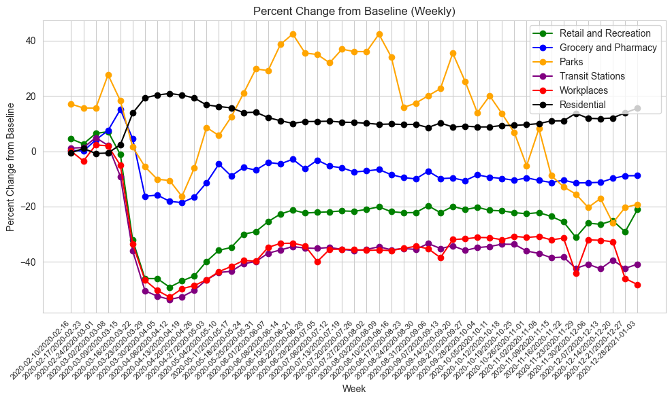
Comparing CO levels and Retail mobility metric for populations over 500k (Feb-Dec,2020)

Slide 8
Retail and Recreation

Slide 9
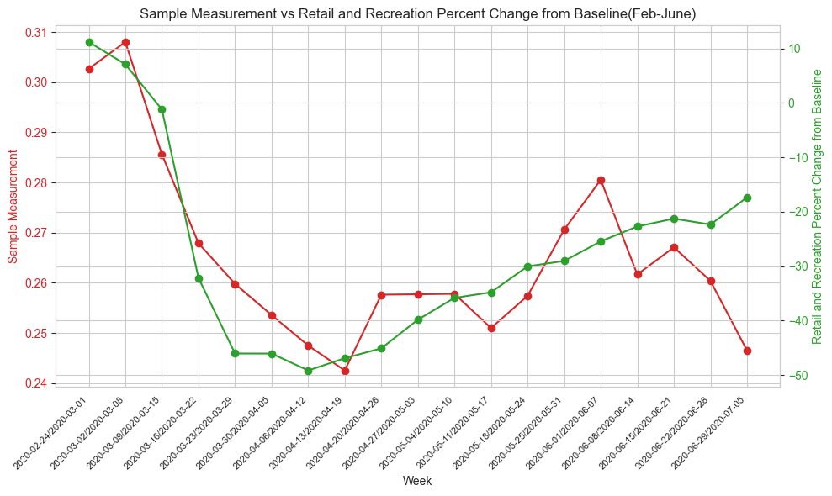
Comparing CO levels and Retail mobility metric for populations over 500k (Feb-June,2020)

Slide 10
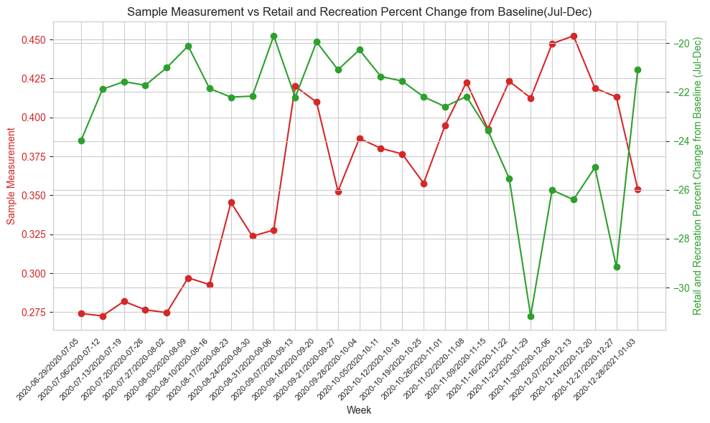
Comparing CO levels and Retail mobility metric for populations over 500k (July-December,2020)

Slide 11
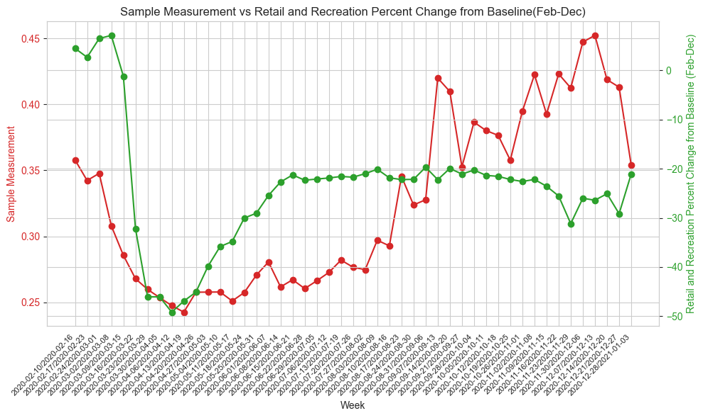
Comparing CO levels and Retail mobility metric for populations over 500k (Feb-Dec,2020)

Slide 12
Interpretation based on the visualization (Feb-Dec -More than 500K)
By Plotting each mobility metric with sample mean measurement every week from Feb Jun and Jul-Dec we can observe that there is positive correlation between both.
From first graph analysis Feb-Jun we can conclude that the pollution has decreased during lockdown, for every 10% reduction of people travelling for retail and recreation there almost 0.01 ppm reduction in pollution during first few weeks(2020-03-08 to 2020-04-19).
After lockdown from Jul-Dec the trend doesn’t seem to be same.

Slide 13
Transit Station

Slide 14
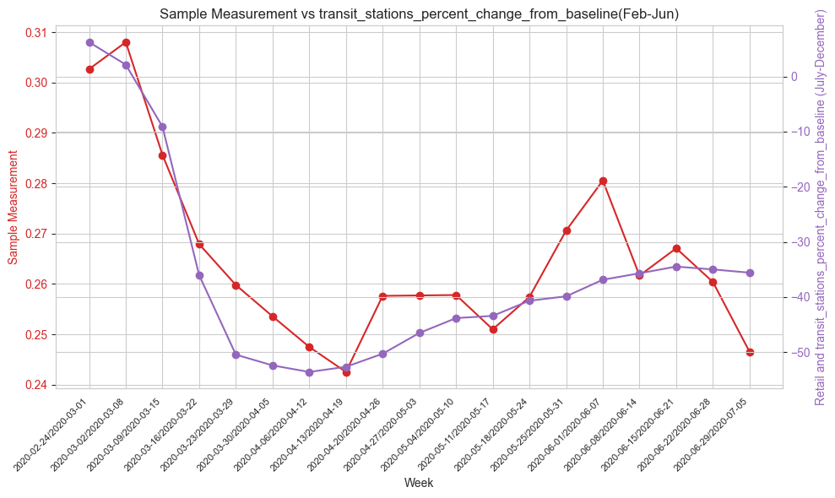
Comparing CO levels and Transit Station mobility for populations over 500k(Feb-Dec,2020)

Slide 15
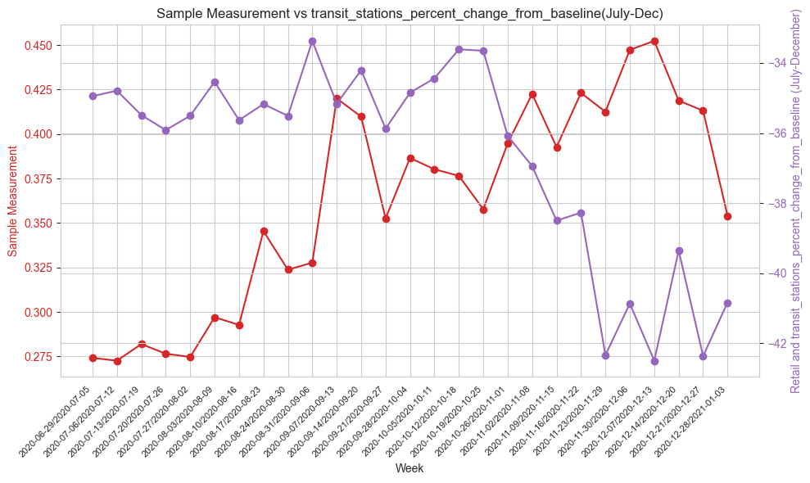
Visualization comparing CO levels and Retail mobility metric for populations over 500k (July-December,2020)

Slide 16
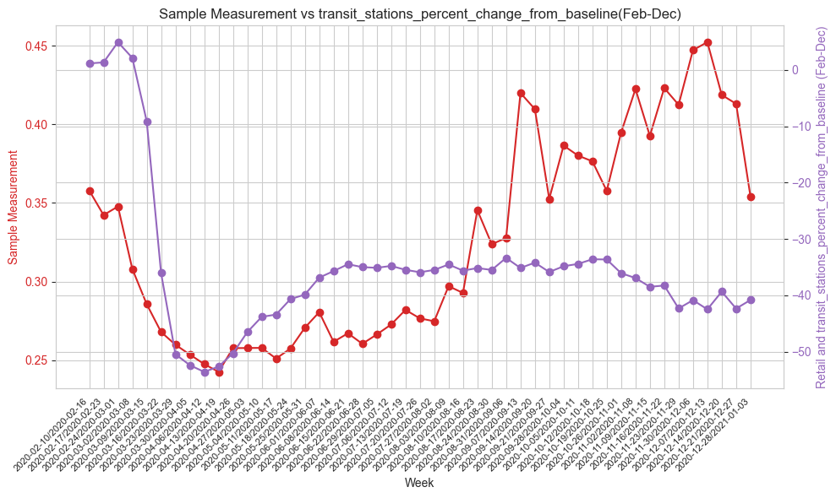
Comparing CO levels and Transit Station mobility for populations over 500k (Feb-Dec,2020)

Slide 17
Interpretation based on the visualization (Feb-Dec -More than 500K)
By Plotting Transit Station mobility metric with sample mean measurement every week from Feb -Jun and Jul-Dec we can observe that there is positive correlation between both.
From first graph analysis Feb-Jun we can conclude that the pollution has decreased during lockdown, for every 20% reduction of people travelling for Transit stations there’s almost 0.015ppm reduction in pollution during first 2 weeks(2020-03-08 to 2020-04-19).
In the next 2 weeks the frequency reduced to for every 10% reduction of people traveling to transit stations there’s reduction of 0.01ppm pollution.
After lockdown from Jul-Dec the trend doesn’t seem to be same.

Slide 18
Parks

Slide 19
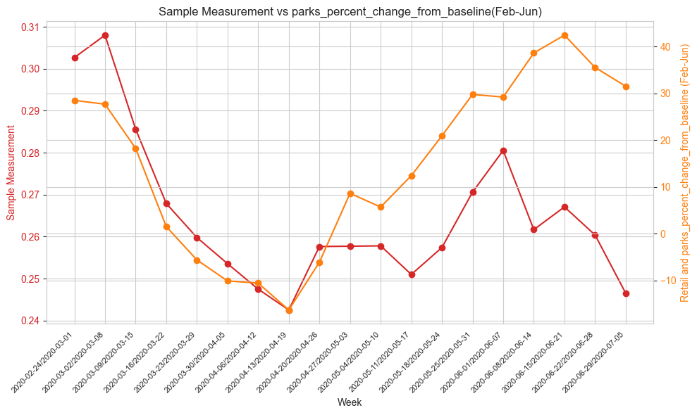
Comparing CO levels and Parks mobility for populations over 500k(Feb-Dec,2020)

Slide 20
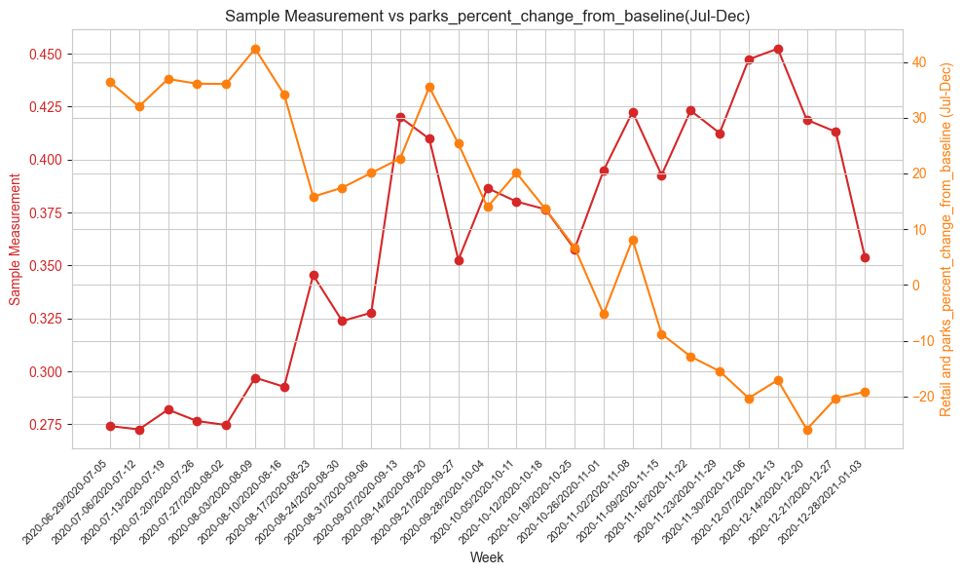
Visualization comparing CO levels and Parks mobility metric for populations over 500k (July-December,2020)

Slide 21
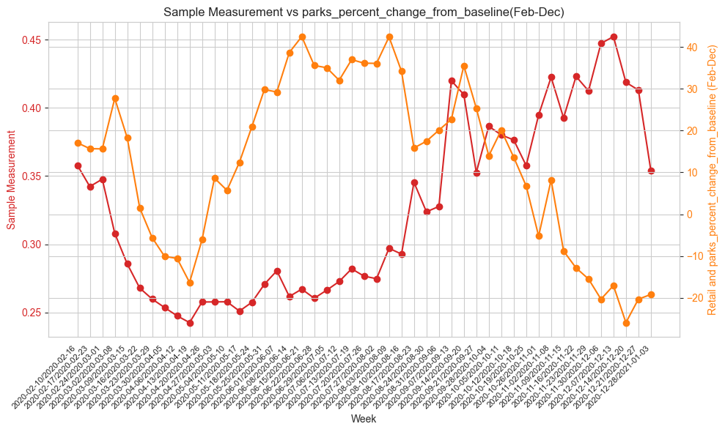
Comparing CO levels and Parks mobility for populations over 500k (Feb-Dec,2020)

Slide 22
Interpretation based on the visualization (Feb-Dec More than 500K)
By Plotting Parks mobility metric with sample mean measurement every week from
Feb -Jun and Jul-Dec we can observe that there is positive correlation between both.
From first graph analysis Feb-Jun we can conclude that the pollution has decreased during lockdown, for every 10% reduction of people travelling for Parks there’s almost 0.015ppm reduction in pollution during first 2 weeks(2020-03-08 to 2020-04-19).
In the next 2 weeks the frequency reduced to for every 10% reduction of people traveling to transit stations there’s reduction of 0.01ppm pollution.
After lockdown from Jul-Dec the trend doesn’t seem to be same and looks like it has positive correlation in the last 2 weeks of lockdown.

Slide 23
Summary:
The trends of pollution reduction is almost same for merices like Retail and Recreation, Transit Stations and workplaces.
Percentage change of people visiting parks is bit different compared to the others and is affecting pollution positively.
Further analysis considering trip data from another data set to see the effects on pollutions levels.

Slide 24
References:
Mobility and the effective reproduction rate of COVID-19
Changes in air pollution due to COVID-19 lockdowns in 2020: Limited effect on NO2, PM2.5, and PM10 annual means compared to the new WHO Air Quality Guidelines
https://abc7news.com/timeline-of-coronavirus-us-covid-19-bay-area-sf/6047519/

Slide 25
Thank you!

